Slide 1
Introduction to CSS
Week 02.

Slide 2
Objectives
Describe the syntax and characteristics of CSS;
Describe the various selectors in CSS;
Demonstrate how to use CSS with HTML.

Slide 3
Tools Required
Visual Studio Code
Browser
Google Chrome (recommended)
Mozilla Firefox

Slide 4
CSS

Slide 5
What is CSS?
CSS or Cascading Style Sheet, is a ”style sheet language” that lets you style web pages through their elements.
CSS is embedded inside HTML, but is not HTML itself.

Slide 6

Structure of CSS
CSS consists of "style rules". Each style rule consists of a "selector" and "declarations" of property-value pairs:
E.g.:
selector {
property: value;
property: value;
}

Slide 7
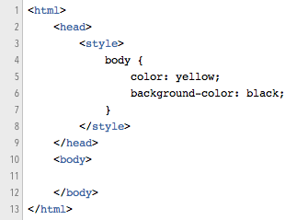
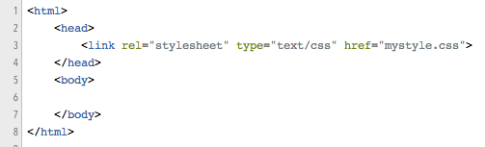
How To Use CSS?
In Style Tag Within Head Tag
Link to External File

Slide 8
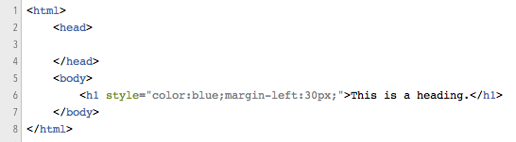
How To Use CSS?
Inline Styles

Slide 9
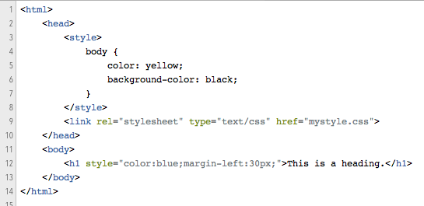
Priorities
What style will be used when there are more than one style specified for an HTML element?
Generally speaking we can say that all the styles will "cascade" into a new "virtual" style sheet by the following rules, where number one has the highest priority:
Inline style (inside an HTML element)
External and internal style sheets (in the head section)
Browser default
So, an inline style (inside a specific HTML element) has the highest priority, which means that it will override a style defined inside the <head> tag, or in an external style sheet, or a browser default value.

Slide 10
Selectors

Slide 11
The Selector
What are Selectors?
Types of Selectors
The selector is used to select which elements in the HTML page will be given the styles inside the curly braces.
element
id
class
position in document
selector {
property: value;
property: value;
}

Slide 12
Selector Type: element
Sets property for the <body> tag.
body {
background-color: #d0e4fe;
}
Sets properties for all the <h1> tag in the entire document.
h1 {
color: orange;
text-align: center;
}
Sets properties for all the <p> tag in the entire document.
p {
font-family: “Times New Roman”;
font-size: 20px;
}

Slide 13
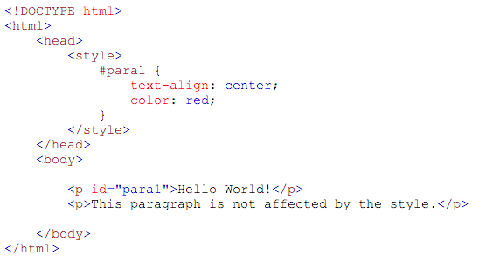

Selector Type: id
Sets properties for any element with the id “para1”.
The “#” is to tell the browser that it is an id.
id’s are unique.
Each element can have only one id.
Each page can have only one element with that id.

Slide 14
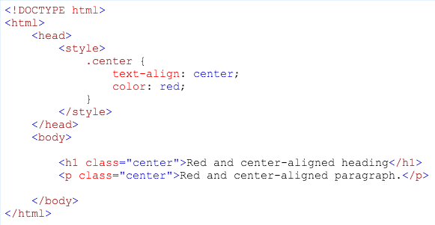

Selector Type: class (for all elements)
Sets properties for any element with the class “center”.
The “.” is to tell the browser that it is a class.
Multiple elements can have the same class.
An element can have multiple classes.

Slide 15
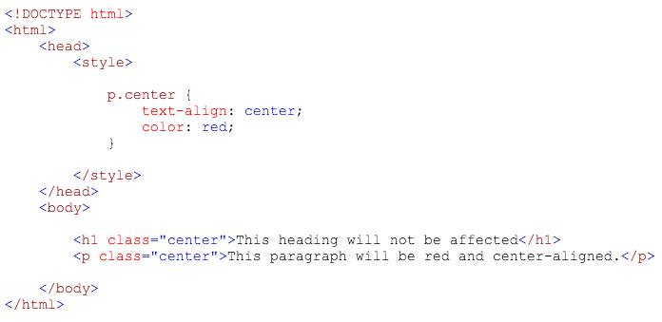

Selector Type: class (for a particular element)
Sets properties for <p> tag elements with the class “center”.
The “p.” is to tell the browser that it is a class for <p> tag.
<h1> tag will not be affected.

Slide 16
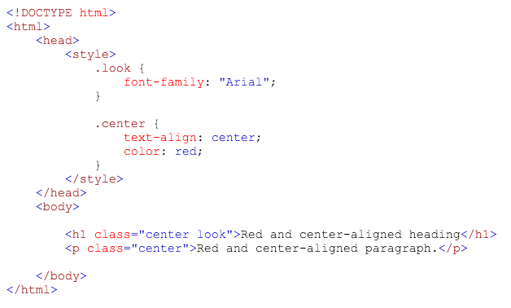

Selector Type: class (multiple classes)
Sets properties for any element with the classes “look” and “center”.
Use of multiple classes is written with space as separator: “look center”.

Slide 17
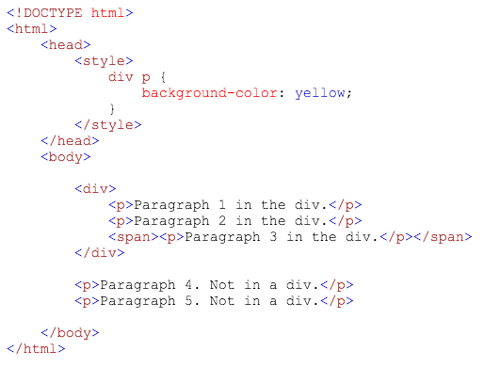
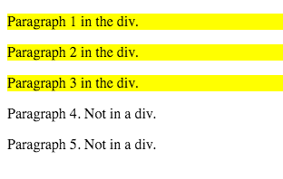
Selector Type: descendent
Sets property for the descendent element (<p>) of a parent element (<div>).
<div> tag defines a division or a section in an HTML document.
By default, browsers always place a line break before and after the <div> element.

Slide 18
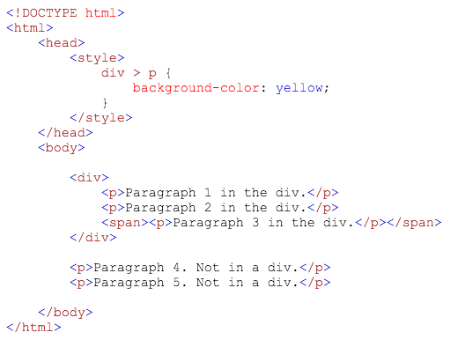
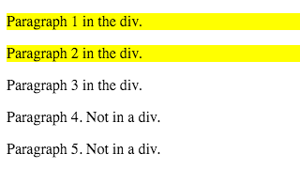
Selector Type: child
Sets property for the child element (<p>) of a parent element (<div>).
This is not a child but a descendent so not affected!

Slide 19
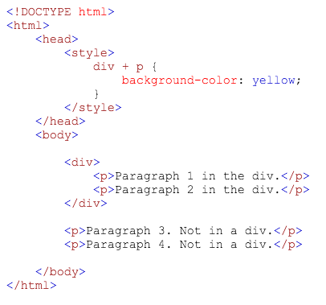
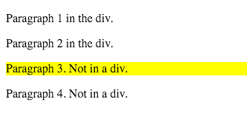
Selector Type: adjacent sibling
Sets property for the element that is adjacent to another (<p> is adjacent to <div>).

Slide 20
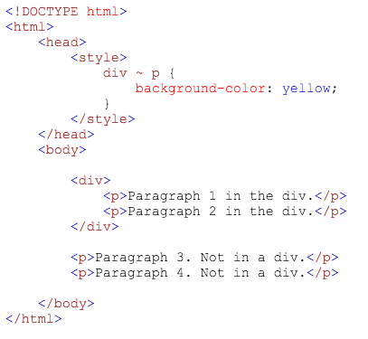
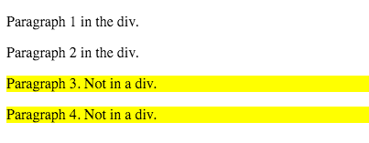
Selector Type: general sibling
Sets property for the next elements (<p>) after a particular element (<div>).

Slide 21
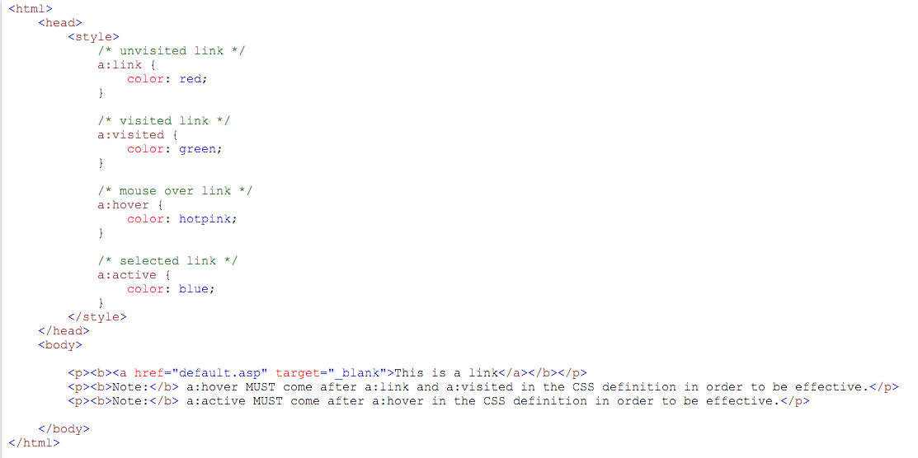
Selector Type: pseudo classes
Sets the text link of an anchor tag <a> to red if it is unvisited.
A pseudo-class is used to define a special state of an element. Try it here.

Slide 22
challenge
W2.1 Intro to CSS.docx

Slide 23
The End

